Slide 1
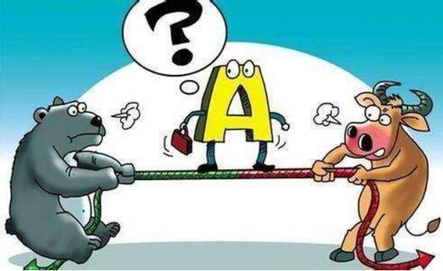
Investor Belief and Market Efficiency
21110680057 Haiqin Liu
— Sentiment Analysis Based on Chinese Stock Market Forum
Notes:
可以改成文章；那had better avoid Chinese or a loss of external validity

Slide 2
Guidelines
Introduction
Project Roadmap
Summary Statistics
Main results
Conclusion
Notes:
P1
S1 research question, potential channels, bottlenecks
S2-1 cite existing research, besides Wei xiong, Kelly bryan, Wolfgang; (1) data science, ml [besides neural network, LDA, why convolutional neural network works better for textual analysis (2) finance (3) machine learning in finance, textual analysis in finance, 用机器学习方法研究sentiment，stock market，finance的英文文献；
S2-2 说明没有专门针对中文金融市场的研究，这是motivation
S3 Roadmap [贴slides+被解释变量]

Slide 3
Introduction
Research Questions
How to quantify investor sentiment from stock forum information ?
(2) How does it predict stock market performance ?
Methodology
Sentiment analysis based on machine learning tools
(2) Forecast power of sentiment score on stock price/liquidity
Potential Pitfalls
Chinese textual analysis specific for financial market can be challenging (a lack of labeled dataset, complexity of Chinese structure, and unique feature of finance terminology)
(2) Investor sentiment can be endogenously/reversely determined by stock market performance, what if we want to investigate something causal ?
Notes:
So there are a measurement issue and an efficiency issue

Slide 4
Guidelines
Introduction
Project Roadmap
Summary Statistics
Main results
Conclusion
Notes:
P1
S1 research question, potential channels, bottlenecks
S2-1 cite existing research, besides Wei xiong, Kelly bryan, Wolfgang; (1) data science, ml [besides neural network, LDA, why convolutional neural network works better for textual analysis (2) finance (3) machine learning in finance, textual analysis in finance, 用机器学习方法研究sentiment，stock market，finance的英文文献；
S2-2 说明没有专门针对中文金融市场的研究，这是motivation
S3 Roadmap [贴slides+被解释变量]

Slide 5
Scrape stock forum comments for stocks double-listed on A-share and NYSE
(http://guba.eastmoney.com/ and https://www.fool.com/)
1
For each stock, identify bad news including
if the firm issued bonds, downgraded or outlook turn negative
financial report announcement date and net profit/ROE etc. turns out to be negative/abnormally decrease
a major policy with negative impact on its industry
For samples one week after bad news, labeled as NEGATIVE
2
A Labeled dataset, which to some extent is more comprehensive than manually annotated one
For each stock, identify good news including
if the firm issued bonds, upgraded or outlook turn positive or keep stable
financial report announcement date and net profit/ROE etc. turns out to be positive/abnormally increase
For samples one week after good news, labeled as POSITIVE
Information got from WIND, currently sample only includes bond issuers, but strategy can be facilitated
3
jieba cut (https://github.com/fxsjy/jieba)+ word2vec from genism to lemmatize words
4
train a CNN classifier and evaluate in-sample performance (https://github.com/linguishi/chinese_sentiment)
Notes:
- There are, to be honest, a whole bunch of ways to identify abnormality, which I would like not to go further
- Negative policy: one month before, let’s say Aug. the 3rd, there is a major bad news for education stock; In July, there’s a very significant bad news for munipal bonds for anyone who is familiar with Chinese bond market, so that the stock price of some state-owned enterprises went down dramatically; and in June I believe, there’s a bad news for cosmetic medicine, and this month you know, it’s for coal industry
- Positive policy: ?I don’t think they are very unambiguous, at least not for the practitioners, so I didn’t include policy here.
Additional tests: analyst report, (but there is manipulation
I believe labeled data constructed in this way can be more comprehensive than manually annotated ones since it’s a sophisticated capital market and I take advantage of information that everybody in the industry knows, but not everybody knows.
[可能为了control，有时候再去检验一个pretrend]

Slide 6
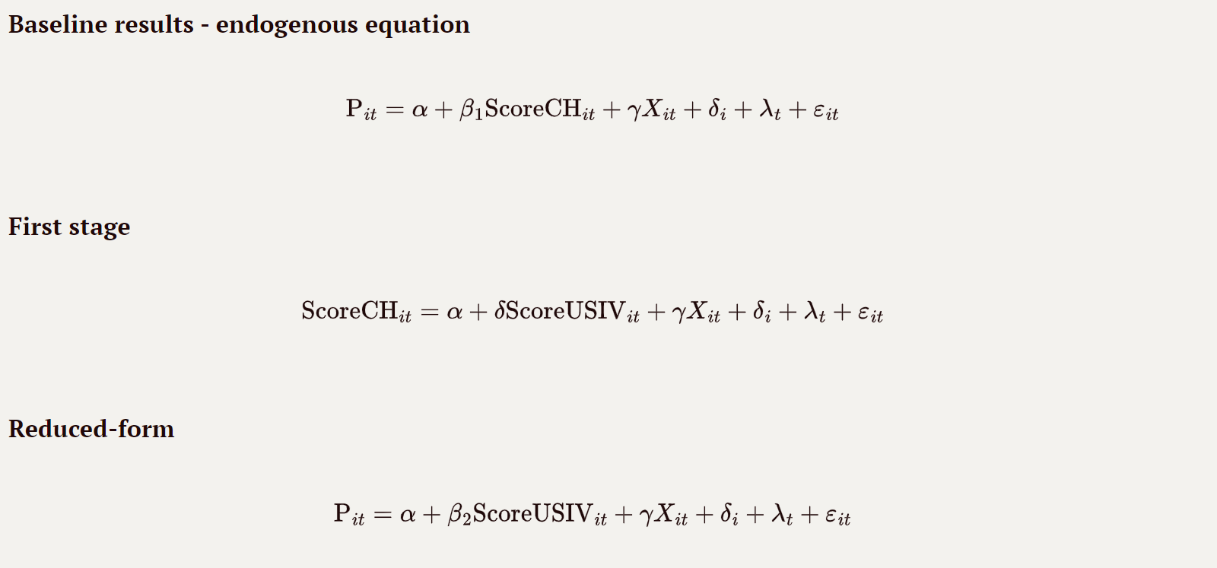
5
Use the classifier to predict sentiment score for the unlabeled samples.
5
Conduct the same exercise, but using news scraped from WSJ chinese.
(here I use the textual analysis package available in python directly)
6
Estimation:
Given the fact that sentiment of US investors are exogenous to Chinese traders a prior, the Wald estimator β₂/δ gives the causal effect of investor sentiment on stock price
Notes:
- There are, to be honest, a whole bunch of ways to identify abnormality, which I would like not to go further
- Negative policy: one month before, let’s say Aug. the 3rd, there is a major bad news for education stock; In July, there’s a very significant bad news for munipal bonds for anyone who is familiar with Chinese bond market, so that the stock price of some state-owned enterprises went down dramatically; and in June I believe, there’s a bad news for cosmetic medicine, and this month you know, it’s for coal industry
- Positive policy: ?I don’t think they are very unambiguous, at least not for the practitioners, so I didn’t include policy here.
Additional tests: analyst report, (but there is manipulation
I believe labeled data constructed in this way can be more comprehensive than manually annotated ones since it’s a sophisticated capital market and I take advantage of information that everybody in the industry knows, but not everybody knows.
[可能为了control，有时候再去检验一个pretrend]

Slide 7
Guidelines
Introduction
Project Roadmap
Summary Statistics
Main results
Conclusion
Notes:
P1
S1 research question, potential channels, bottlenecks
S2-1 cite existing research, besides Wei xiong, Kelly bryan, Wolfgang; (1) data science, ml [besides neural network, LDA, why convolutional neural network works better for textual analysis (2) finance (3) machine learning in finance, textual analysis in finance, 用机器学习方法研究sentiment，stock market，finance的英文文献；
S2-2 说明没有专门针对中文金融市场的研究，这是motivation
S3 Roadmap [贴slides+被解释变量]

Slide 8
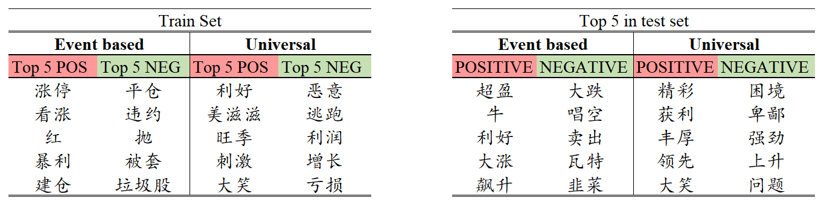
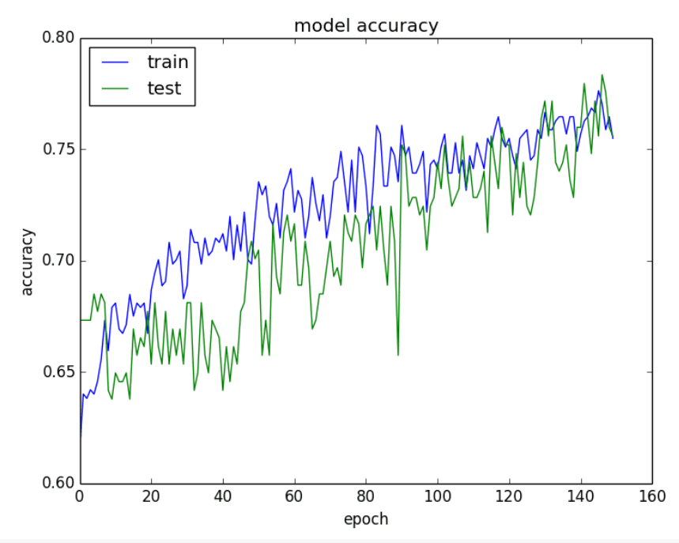
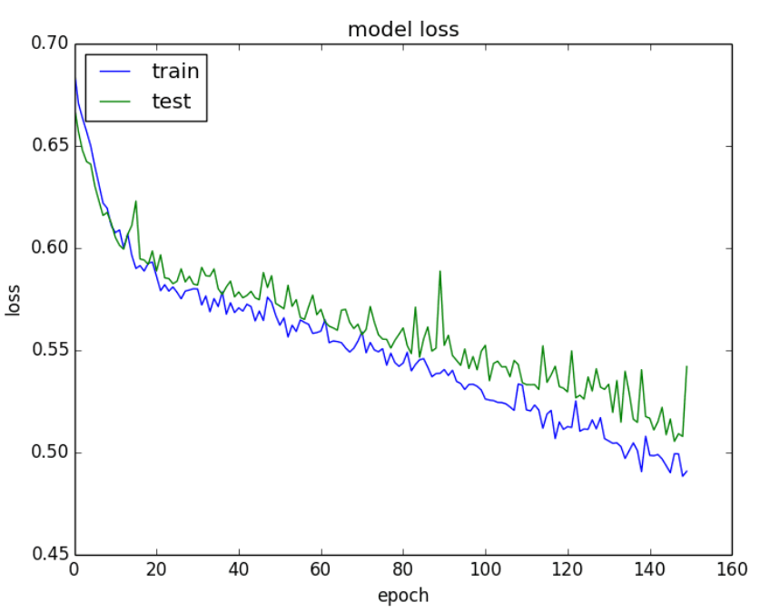
Labeling Strategy Effectiveness and In-sample performance
Notes:
Maybe a small sample, but I will think out increase the sample size by including other markets like Singapore, Europe, Hong Kong etc.

Slide 9
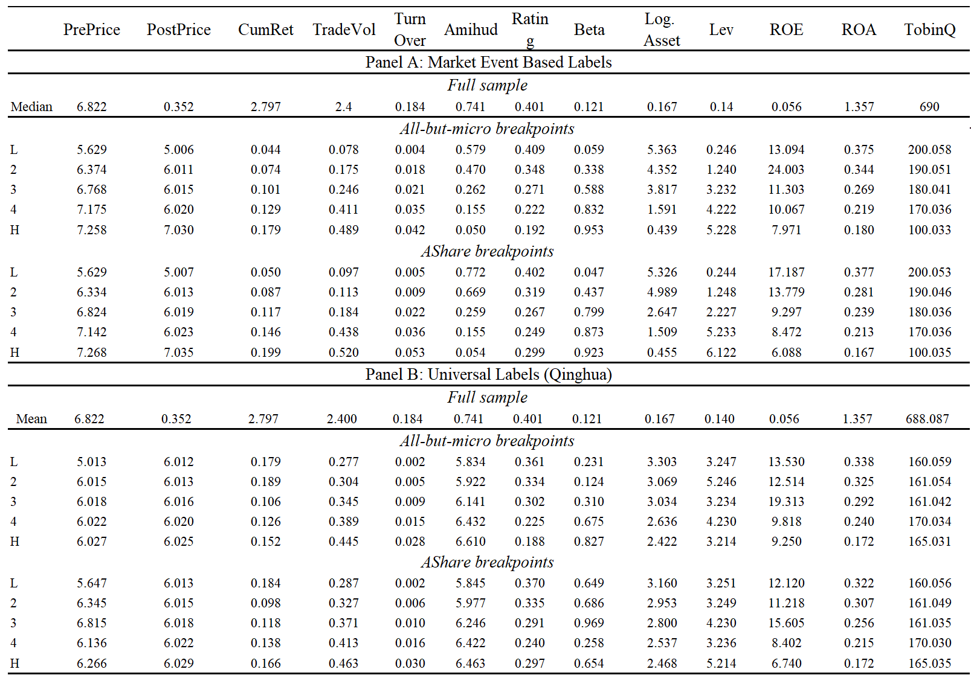
Descriptive statistics (sorted on sentiment score quintiles)
outperform the universal labels in the sense that it captures significantly larger variations across sentiment portfolios
“hot” stocks are
higher priced
more liquid
larger risk exposure
smaller
more leveraged
overvalued
some evidence of irrationality and market inefficiency
measure based on universal labels, however, are rather noisy and show few variation across sentiment quintiles
Notes:
Maybe a small sample, but I will think out increase the sample size by including other markets like Singapore, Europe, Hong Kong etc.

Slide 10
Guidelines
Introduction
Project Roadmap
Summary Statistics
Main Results
Conclusion
Notes:
P1
S1 research question, potential channels, bottlenecks
S2-1 cite existing research, besides Wei xiong, Kelly bryan, Wolfgang; (1) data science, ml [besides neural network, LDA, why convolutional neural network works better for textual analysis (2) finance (3) machine learning in finance, textual analysis in finance, 用机器学习方法研究sentiment，stock market，finance的英文文献；
S2-2 说明没有专门针对中文金融市场的研究，这是motivation
S3 Roadmap [贴slides+被解释变量]

Slide 11
Baseline regressions

Slide 12
Reduced form regressions

Slide 13
2SLS estimation

Slide 14
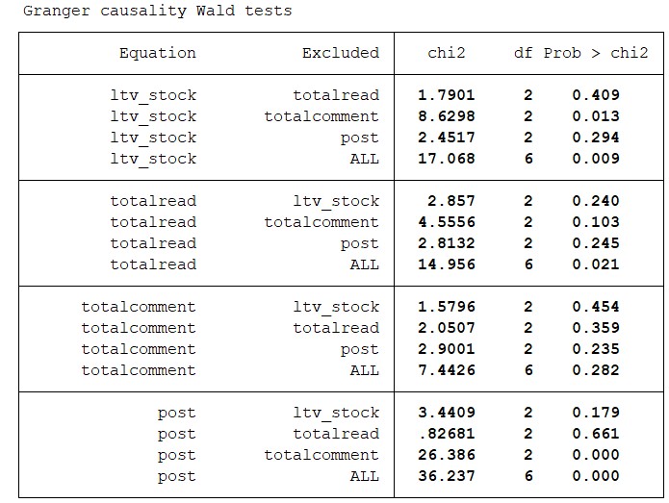
VAR模型步骤——以格力电器为例
变量统计详见附表3
1. 格兰杰因果检验 → 是否存在互为因果的内生性
格力电器股吧当天总帖数和总阅读量是未来该股票交易量的“因”，而该股票当天的总评论量不是。
格力电器当天股票交易量是未来股吧总帖数、总阅读量和总评论量的“因”。

Slide 15
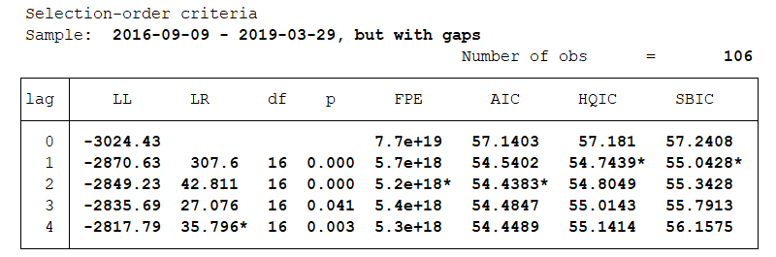
VAR模型步骤——以格力电器为例
2. 确定滞后期数
取最小化AIC指标的滞后阶数2进行向量自回归分析

Slide 16
VAR模型步骤
3. 向量自回归结果
格力电器的股票交易量增长率与其前两日的股票交易增长率有正向关系，且随时间逐渐递减。前一日股吧阅读量的上升10000将使第二天股票交易量增加2‱。
格力电器股吧的总帖数和总阅读量与前一日股票增长率有负向关系。

Slide 17
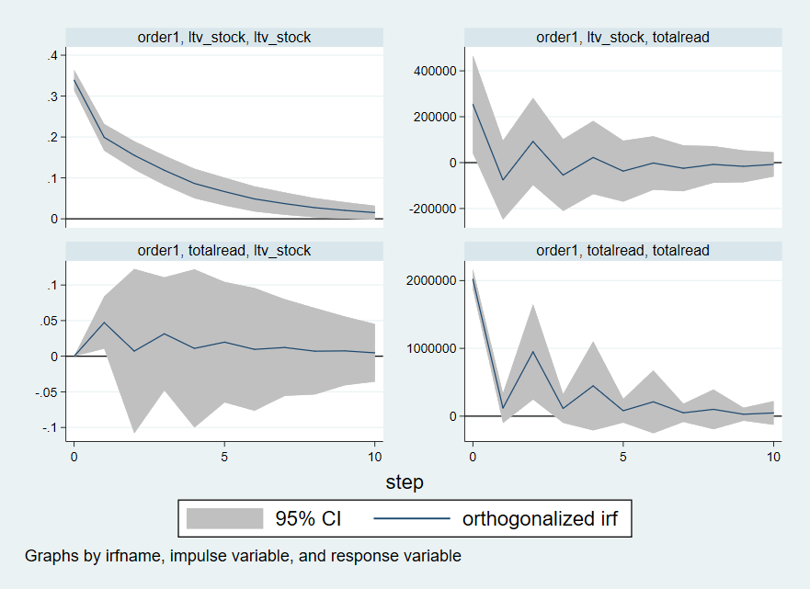
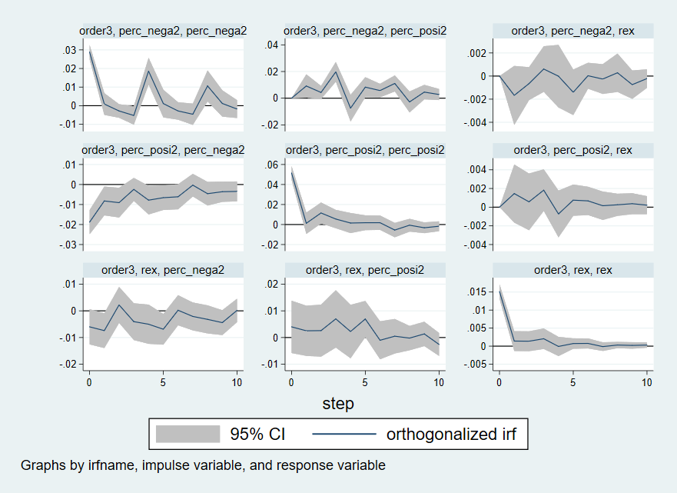
Average impulse response

Slide 18
Panel Level ——All stocks significance summary
each stock see Appendix Table 2
relation | variables | lags | + | - | 假设检验
交易量与关注度 | ltv_s&posts/read/comment | 3.58 | 8 | 0 | √
交易量与观点差异 | ltv_s&dispersion1 | 3.74 | 8 | 1 | √
 | ltv_s&dispersion2 | 3.37 | 6 | 0 | √
超额收益率和论坛情绪 | rex&score1 | 3.5 | 6 | 6 | -
 | rex&score2 | 3.05 | 2 | 3 | ×
波动率与关注度 | volatility&score1 | 3.16 | 6 | 2 | √
 | volatility&score2 | 3.74 | 3 | 4 | ×
 | volatility&posts/read/comment | 3.42 | 6 | 2 | √

Slide 19
Guidelines
Introduction
Project Roadmap
Summary Statistics
Main Results
Conclusion
Notes:
P1
S1 research question, potential channels, bottlenecks
S2-1 cite existing research, besides Wei xiong, Kelly bryan, Wolfgang; (1) data science, ml [besides neural network, LDA, why convolutional neural network works better for textual analysis (2) finance (3) machine learning in finance, textual analysis in finance, 用机器学习方法研究sentiment，stock market，finance的英文文献；
S2-2 说明没有专门针对中文金融市场的研究，这是motivation
S3 Roadmap [贴slides+被解释变量]

Slide 20
Pros and cons
Pros
Event based labels
Particular for Chinese financial market
High frequency data
Capture intuitive variations
Cons
Sentiment and market performance across countries are not necessarily uncorrelated
Not cross-validated by other classification model
Choice of events: might have included policy related events w.r.t. China

Slide 21
Appendix Table 1.Summary statistics of unsupervised learning sentiment score
stock |  | score1 | score2 | dispersion1 | dispersion2 | daily posts | stock |  | score1 | score2 | dispersion1 | dispersion2 | daily posts
159 | mean | 9.45 | -18.02 | 0.23 | 0.23 | 130.54 | 927 | mean | 5.81 | 0.88 | 0.11 | 0.06 | 69.08
 | sd | 11.04 | 13.61 | 0.05 | 0.05 | 261.94 |  | sd | 4.92 | 2.68 | 0.04 | 0.05 | 138.63
 | p50 | 8.31 | -18.65 | 0.24 | 0.24 | 17.00 |  | p50 | 5.32 | 0.45 | 0.11 | 0.06 | 37.50
338 | mean | -0.65 | -3.48 | 0.07 | 0.09 | 61.30 | 2118 | mean | -5.98 | -21.73 | 0.21 | 0.20 | 148.86
 | sd | 2.22 | 5.37 | 0.06 | 0.04 | 63.70 |  | sd | 6.61 | 6.50 | 0.05 | 0.04 | 197.27
 | p50 | -0.46 | -2.50 | 0.06 | 0.08 | 48.50 |  | p50 | -7.22 | -22.48 | 0.21 | 0.21 | 75.00
651 | mean | -12.88 | 16.01 | 0.22 | 0.25 | 174.40 | 2450 | mean | 1.01 | -21.65 | 0.14 | 0.20 | 481.34
 | sd | 2.76 | 2.99 | 0.02 | 0.02 | 234.20 |  | sd | 3.41 | 3.58 | 0.02 | 0.03 | 373.04
 | p50 | -13.17 | 16.39 | 0.23 | 0.25 | 131.00 |  | p50 | 0.43 | -22.18 | 0.14 | 0.21 | 456.00
681 | mean | 1.60 | 0.19 | 0.05 | 0.01 | 60.85 | 2565 | mean | -3.74 | -24.56 | 0.20 | 0.29 | 367.24
 | sd | 2.56 | 0.67 | 0.04 | 0.02 | 378.02 |  | sd | 6.84 | 11.21 | 0.04 | 0.05 | 545.13
 | p50 | 1.10 | 0.00 | 0.04 | 0.00 | 8.00 |  | p50 | -5.51 | -22.26 | 0.20 | 0.28 | 158.00
723 | mean | -9.74 | -20.84 | 0.15 | 0.28 | 314.01 | 600030 | mean | -19.84 | 7.34 | 0.22 | 0.14 | 230.43
 | sd | 4.69 | 9.10 | 0.04 | 0.07 | 703.82 |  | sd | 6.81 | 3.74 | 0.03 | 0.04 | 499.66
 | p50 | -10.79 | -21.07 | 0.15 | 0.29 | 69.50 |  | p50 | -20.25 | 7.31 | 0.22 | 0.14 | 66.00
725 | mean | -5.93 | 1.80 | 0.17 | 0.07 | 424.13 | 600150 | mean | 0.22 | -21.38 | 0.12 | 0.20 | 58.89
 | sd | 3.30 | 1.28 | 0.04 | 0.03 | 467.83 |  | sd | 4.79 | 8.42 | 0.03 | 0.04 | 92.36
 | p50 | -6.14 | 1.69 | 0.18 | 0.08 | 147.00 |  | p50 | 0.20 | -22.52 | 0.12 | 0.21 | 30.00
735 | mean | 11.57 | 19.78 | 0.21 | 0.20 | 510.45 | 600218 | mean | -10.06 | -17.75 | 0.20 | 0.26 | 212.20
 | sd | 2.90 | 4.24 | 0.03 | 0.02 | 359.19 |  | sd | 5.93 | 7.07 | 0.04 | 0.05 | 230.62
 | p50 | 11.74 | 20.53 | 0.21 | 0.20 | 592.00 |  | p50 | -11.75 | -18.97 | 0.21 | 0.27 | 150.00
858 | mean | -6.17 | -4.38 | 0.11 | 0.12 | 87.34 | 600352 | mean | 8.60 | -21.29 | 0.20 | 0.22 | 200.72
 | sd | 2.83 | 3.68 | 0.03 | 0.05 | 124.86 |  | sd | 5.57 | 7.49 | 0.04 | 0.03 | 464.80
 | p50 | -6.32 | -4.19 | 0.11 | 0.13 | 60.00 |  | p50 | 9.53 | -22.85 | 0.21 | 0.22 | 37.00
862 | mean | -6.17 | -4.38 | 0.11 | 0.12 | 87.34 | 600519 | mean | -5.44 | -4.78 | 0.20 | 0.11 | 153.30
 | sd | 2.83 | 3.68 | 0.03 | 0.05 | 124.86 |  | sd | 7.46 | 5.39 | 0.06 | 0.04 | 216.97
 | p50 | -6.32 | -4.19 | 0.11 | 0.13 | 60.00 |  | p50 | -4.83 | -3.86 | 0.21 | 0.11 | 97.00

Slide 22
Appendix Table 2-1.VAR estimation by stock
stock | relation | variables | Nlags | Impact | Significance
159 | trading volume and stock popularity | ltv_s&posts/read/comment | 4 | -+ | ***
 | trading volume and opinion dispersion | ltv_s&dispersion1 | 4 | + | ***
 |  | ltv_s&dispersion2 | 4 | -
 | excess return and investor sentiment | rex&score1 | 2/4 | - | *
 |  | rex&score2 | 3 | +
 | volatility of return and investor sentiment/stock popularity | volatility&score1 | 4 | +
 |  | volatility&score2 | 4 | -
 |  | volatility&posts/read/comment | 3 | - | **
338 | trading volume and stock popularity | ltv_s&posts/read/comment | 3 | -+ | **
 | trading volume and opinion dispersion | ltv_s&dispersion1 | 4 | -+ | ***
 |  | ltv_s&dispersion2 | 4 | -+ | ***
 | excess return and investor sentiment | rex&score1 | 4 | l4.- | **
 |  | rex&score2 | 4 | l3l4.+ | ***
 | volatility of return and investor sentiment/stock popularity | volatility&score1 | 2 | l2.+ | *
 |  | volatility&score2 | 4 | +-
 |  | volatility&posts/read/comment | 3 | l2.+ | *
651 | trading volume and stock popularity | ltv_s&posts/read/comment | 4 | +- | ***
 | trading volume and opinion dispersion | ltv_s&dispersion1 | 4 | + | ***
 |  | ltv_s&dispersion2 | 4 | -++ | ***
 | excess return and investor sentiment | rex&score1 | 4 | l2.+ | *
 |  | rex&score2 | 3 | +
 | volatility of return and investor sentiment/stock popularity | volatility&score1 | 4 | + | ***
 |  | volatility&score2 | 4 | ++- | ***
 |  | volatility&posts/read/comment | 3 | + | *
stock | relation | variables | Nlags | Impact | Significance
681 | 交易量与关注度 | ltv_s&posts/read/comment | 4 | -+ | ***
 | 交易量与观点差异 | ltv_s&dispersion1 | 4 | +
 |  | ltv_s&dispersion2 | 4 | -+ | ***
 | 超额收益率和论坛情绪 | rex&score1 | 4 | -+
 |  | rex&score2 | 4 | -+ | ***
 | 波动率与关注度 | volatility&score1 | 4 | -+ | **
 |  | volatility&score2 | 4 | -+ | ***
 |  | volatility&posts/read/comment | 4 | - | *
723 | 交易量与关注度 | ltv_s&posts/read/comment | 3 | -+
 | 交易量与观点差异 | ltv_s&dispersion1 | 1 | -+
 |  | ltv_s&dispersion2 | 4 | + | **
 | 超额收益率和论坛情绪 | rex&score1 | 4 | - | ***
 |  | rex&score2 | 4 | -
 | 波动率与关注度 | volatility&score1 | 4 | -+ | ***
 |  | volatility&score2 | 4 | - | *
 |  | volatility&posts/read/comment | 3 | +
725 | 交易量与关注度 | ltv_s&posts/read/comment | 4 | + | ***
 | 交易量与观点差异 | ltv_s&dispersion1 | 4 | + | ***
 |  | ltv_s&dispersion2 | 1 | +
 | 超额收益率和论坛情绪 | rex&score1 | 4 | ++ | *
 |  | rex&score2 | 0
 | 波动率与关注度 | volatility&score1 | 4 | +++ | ***
 |  | volatility&score2 | 4 | + | *
 |  | volatility&posts/read/comment | 4 | -+ | ***

Slide 23
Appendix Table 2-2.VAR estimation by stock
stock | relation | variables | Nlags | Impact | Significance
735 | 交易量与关注度 | ltv_s&posts/read/comment | 3 | + | **
 | 交易量与观点差异 | ltv_s&dispersion1 | 4 | -+
 |  | ltv_s&dispersion2 | 3 | -
 | 超额收益率和论坛情绪 | rex&score1 | 4 | - | *
 |  | rex&score2 | 0
 | 波动率与关注度 | volatility&score1 | 4 | +-
 |  | volatility&score2 | 0
 |  | volatility&posts/read/comment | 3 | l3.+ | *
858 | 交易量与关注度 | ltv_s&posts/read/comment | 3 | +- | ***
 | 交易量与观点差异 | ltv_s&dispersion1 | 4 | -+ | *
 |  | ltv_s&dispersion2 | 4 | -+ | **
 | 超额收益率和论坛情绪 | rex&score1 | 0
 |  | rex&score2 | 3 | l3.- | *
 | 波动率与关注度 | volatility&score1 | 0
 |  | volatility&score2 | 4 | l4.- | **
 |  | volatility&posts/read/comment | 4 | -+ | ***
862 | 交易量与关注度 | ltv_s&posts/read/comment | 3 | -+
 | 交易量与观点差异 | ltv_s&dispersion1 | 4 | l3l4.+ | **
 |  | ltv_s&dispersion2 | 4 | +
 | 超额收益率和论坛情绪 | rex&score1 | 4 | -+- | ***
 |  | rex&score2 | 1 | -
 | 波动率与关注度 | volatility&score1 | 4 | - | ***
 |  | volatility&score2 | 4 | l3.- | *
 |  | volatility&posts/read/comment | 3 | r+c- | *
stock | relation | variables | Nlags | Impact | Significance
927 | 交易量与关注度 | ltv_s&posts/read/comment | 4 | +- | ***
 | 交易量与观点差异 | ltv_s&dispersion1 | 4 | +- | **
 |  | ltv_s&dispersion2 | 3 | -+-
 | 超额收益率和论坛情绪 | rex&score1 | 4 | +- | ***
 |  | rex&score2 | 4 | +
 | 波动率与关注度 | volatility&score1 | 3 | + | ***
 |  | volatility&score2 | 4 | +- | ***
 |  | volatility&posts/read/comment | 3 | +
2118 | 交易量与关注度 | ltv_s&posts/read/comment | 3 | + | **
 | 交易量与观点差异 | ltv_s&dispersion1 | 4 | + | ***
 |  | ltv_s&dispersion2 | 4 | + | ***
 | 超额收益率和论坛情绪 | rex&score1 | 4 | -+ | ***
 |  | rex&score2 | 4 | l4.+ | **
 | 波动率与关注度 | volatility&score1 | 4 | l3l4.+ | *
 |  | volatility&score2 | 4 | l4.+ | ***
 |  | volatility&posts/read/comment | 3 | l3.+ | *
2450 | 交易量与关注度 | ltv_s&posts/read/comment | 4 | + | ***
 | 交易量与观点差异 | ltv_s&dispersion1 | 4 | -+ | ***
 |  | ltv_s&dispersion2 | 0
 | 超额收益率和论坛情绪 | rex&score1 | 4 | + | ***
 |  | rex&score2 | 4 | +- | ***
 | 波动率与关注度 | volatility&score1 | 4 | +
 |  | volatility&score2 | 4 | +- | **
 |  | volatility&posts/read/comment | 4 | + | ***

Slide 24
Appendix Table 2-3.VAR estimation by stock
stock | relation | variables | Nlags | Impact | Significance
2565 | 交易量与关注度 | ltv_s&posts/read/comment | 4 | +- | ***
 | 交易量与观点差异 | ltv_s&dispersion1 | 4 | + | ***
 |  | ltv_s&dispersion2 | 4 | l2.+ | ***
 | 超额收益率和论坛情绪 | rex&score1 | 3 | l3.- | *
 |  | rex&score2 | 1 | +
 | 波动率与关注度 | volatility&score1 | 4 | -+ | **
 |  | volatility&score2 | 3 | +
 |  | volatility&posts/read/comment | 3 | +-
600030 | 交易量与关注度 | ltv_s&posts/read/comment | 4 | + | ***
 | 交易量与观点差异 | ltv_s&dispersion1 | 4 | - | ***
 |  | ltv_s&dispersion2 | 4 | +- | **
 | 超额收益率和论坛情绪 | rex&score1 | 4 | +- | *
 |  | rex&score2 | 4 | +- | **
 | 波动率与关注度 | volatility&score1 | 4 | - | **
 |  | volatility&score2 | 4 | +- | ***
 |  | volatility&posts/read/comment | 4 | + | ***
600150 | 交易量与关注度 | ltv_s&posts/read/comment | 4 | + | ***
 | 交易量与观点差异 | ltv_s&dispersion1 | 4 | +
 |  | ltv_s&dispersion2 | 4 | + | ***
 | 超额收益率和论坛情绪 | rex&score1 | 4 | +
 |  | rex&score2 | 3 | +-
 | 波动率与关注度 | volatility&score1 | 3 | -
 |  | volatility&score2 | 4 | -
 |  | volatility&posts/read/comment | 4 | +- | ***
stock | relation | variables | Nlags | Impact | Significance
600218 | 交易量与关注度 | ltv_s&posts/read/comment | 4 | + | ***
 | 交易量与观点差异 | ltv_s&dispersion1 | 4 | +- | ***
 |  | ltv_s&dispersion2 | 4 | + | ***
 | 超额收益率和论坛情绪 | rex&score1 | 4 | + | ***
 |  | rex&score2 | 4 | + | ***
 | 波动率与关注度 | volatility&score1 | 1 | -
 |  | volatility&score2 | 4 | +- | ***
 |  | volatility&posts/read/comment | 4 | -+ | ***
600352 | 交易量与关注度 | ltv_s&posts/read/comment | 4 | -+ | ***
 | 交易量与观点差异 | ltv_s&dispersion1 | 3 | + | *
 |  | ltv_s&dispersion2 | 4 | +
 | 超额收益率和论坛情绪 | rex&score1 | 0
 |  | rex&score2 | 4 | l4.- | *
 | 波动率与关注度 | volatility&score1 | 3 | +
 |  | volatility&score2 | 4 | + | ***
 |  | volatility&posts/read/comment | 4 | -+ | ***
600519 | 交易量与关注度 | ltv_s&posts/read/comment | 3 | + | *
 | 交易量与观点差异 | ltv_s&dispersion1 | 4 | + | *
 |  | ltv_s&dispersion2 | 4 | +
 | 超额收益率和论坛情绪 | rex&score1 | 4 | l1.+ | **
 |  | rex&score2 | 4 | l2.- | **
 | 波动率与关注度 | volatility&score1 | 4 | + | ***
 |  | volatility&score2 | 4 | -
 |  | volatility&posts/read/comment | 3 | +- | **

Slide 25
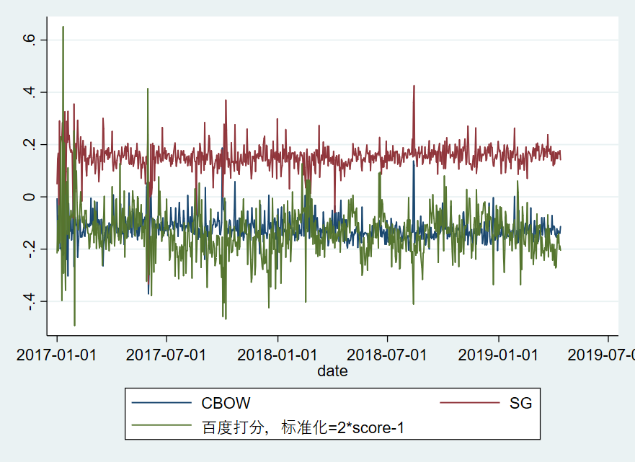
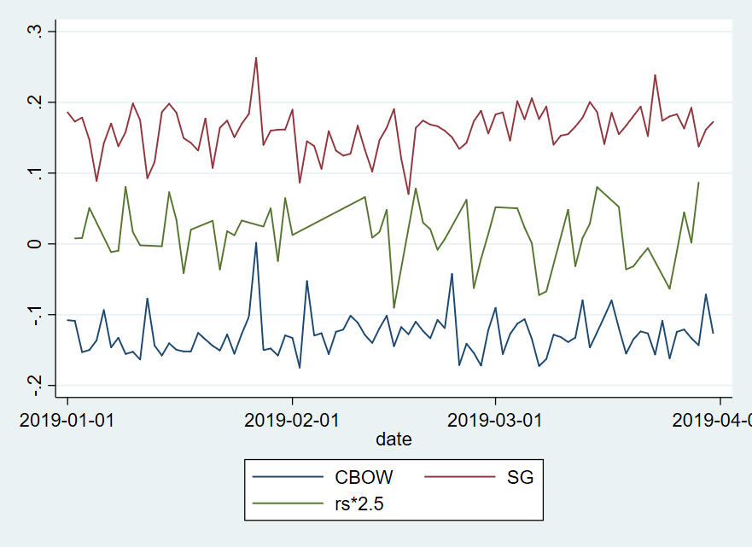
Appendix Table 3. case study: Evergrande (
相对百度打分的情绪波动更大且更为悲观，SG比CBOW更贴近百度的打分，与个股的市场表现（日收益率）贴合的更好。

Slide 26
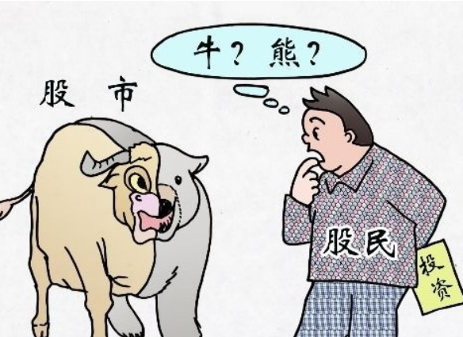
Thanks !

